Slide 1


Chapter 11 Understanding Network Security Zones

Slide 2

Chapter 11 Overview
Understanding risks on the Internet
Exploring an intranet
Understanding firewalls
Identifying a perimeter network
Understanding extranets

Slide 3
Understanding Risks on the Internet
The Internet is the riskiest security zone
All Internet addresses are public
The Internet is TCP/IP based
The World Wide Web travels over the Internet

Slide 4
Exploring an Intranet
Intranet – internal LAN
Private IP addresses
  10.0.0.1 to10.255.255.254
  172.16.0.1 to172.31.255.254
  192.168.1.1 to192.168.255.254

Slide 5
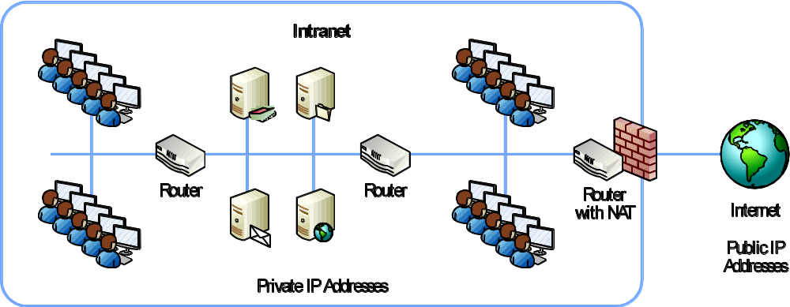
Exploring an Intranet
NAT
  Translates private IPs to public
  Translates public IPs to private

Slide 6

Exploring an Intranet
PAT
  Uses port table
    Receives the request and logs the source IP address and port
    NAT creates a new packet and forward the request to Bing.com
    NAT sends the request to Bing.com which sends the page back
    NAT returns page to original requestor

Slide 7
Exploring an Intranet
NAT benefits
  Hides internal computers
  Reduces costs
  Extended the lifetime of IPv4

Slide 8
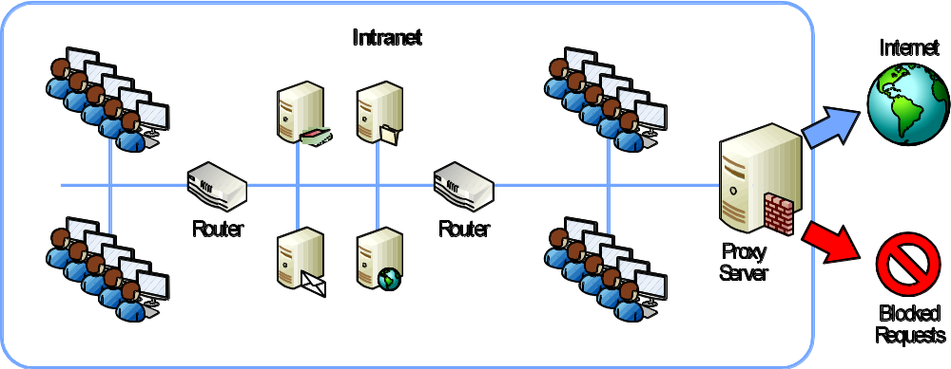
Exploring an Intranet
Understanding proxy servers
  Caching
  Filtering
  Content checking

Slide 9
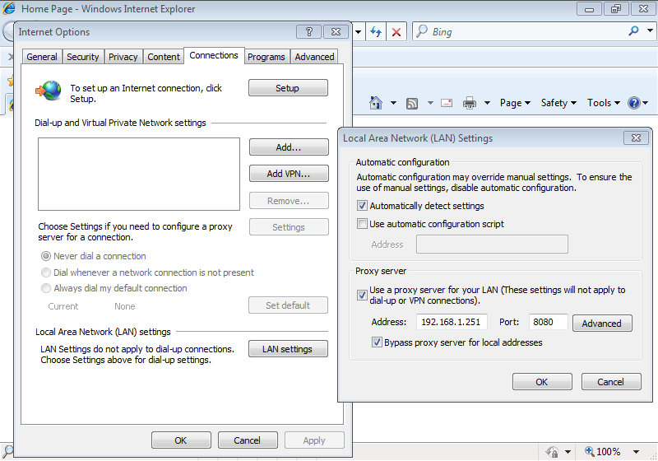
Exploring an Intranet
Configuring IE to use a proxy

Slide 10
Understanding Firewalls
Packet-filtering firewall
Stateful filtering
Content filtering
Application layer filtering

Slide 11
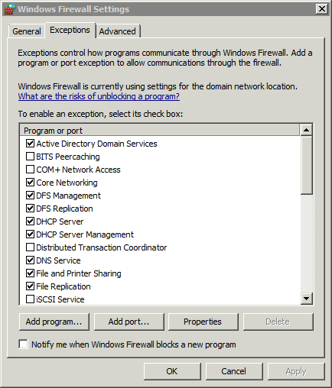
Understanding Firewalls
Windows firewall

Slide 12
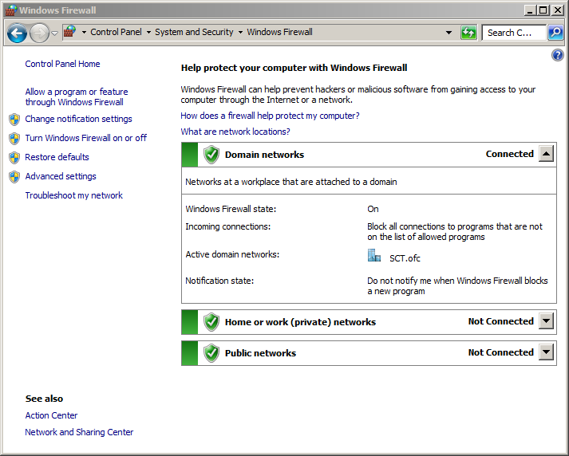
Understanding Firewalls
Windows firewall
  Public
  Home
  Work
  Domain

Slide 13
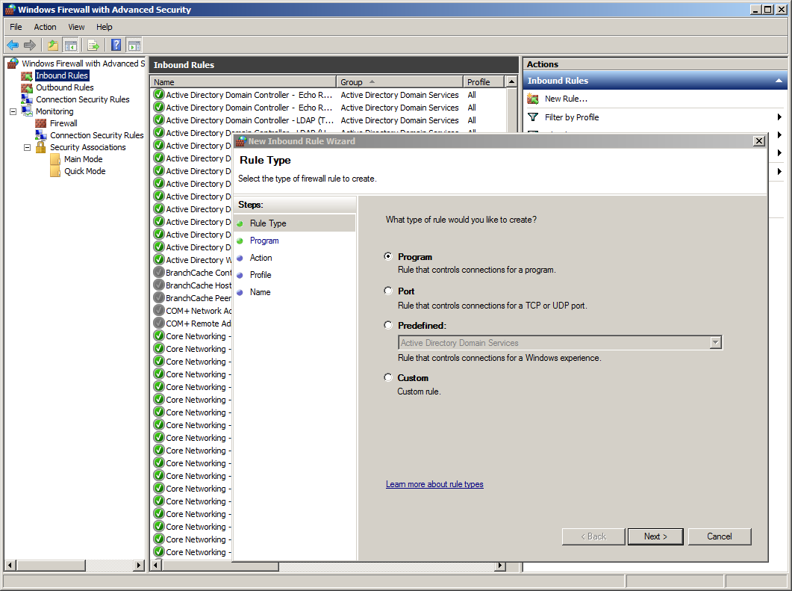
Understanding Firewalls
Windows firewall with advanced security

Slide 14
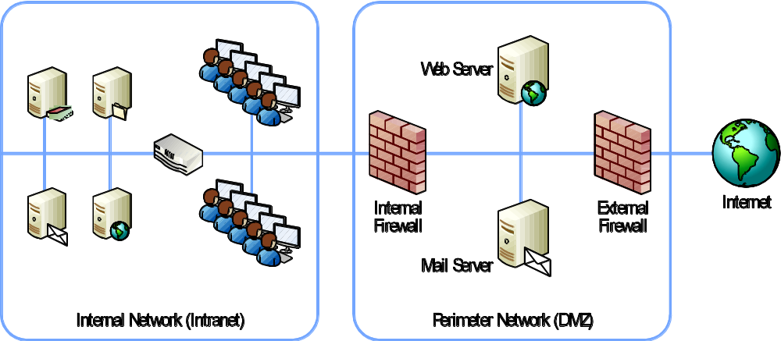
Identifying a
Perimeter Network
Perimeter network
  Area between the Internet and intranet

Slide 15
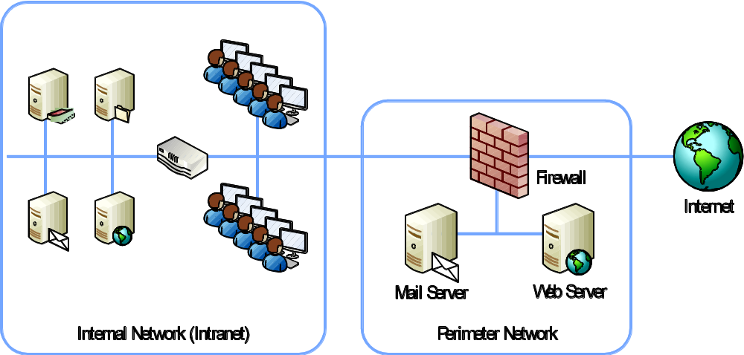
Identifying a
Perimeter Network
Single firewall perimeter network

Slide 16
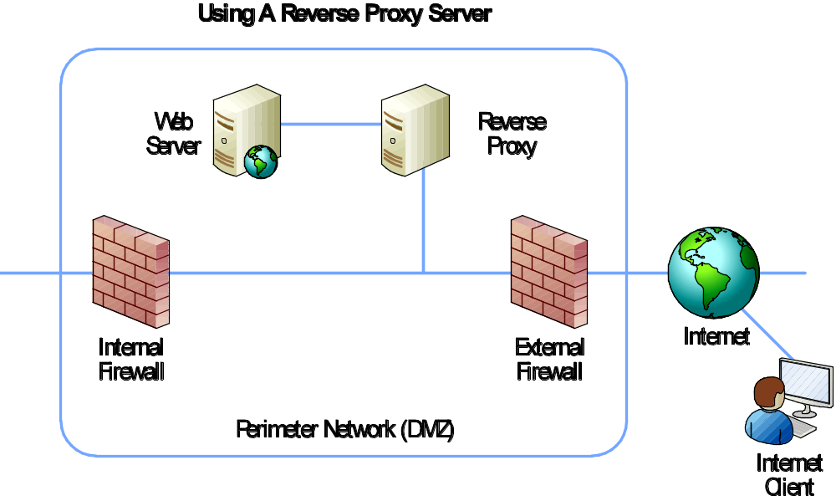
Identifying a
Perimeter Network
Reverse proxy server

Slide 17
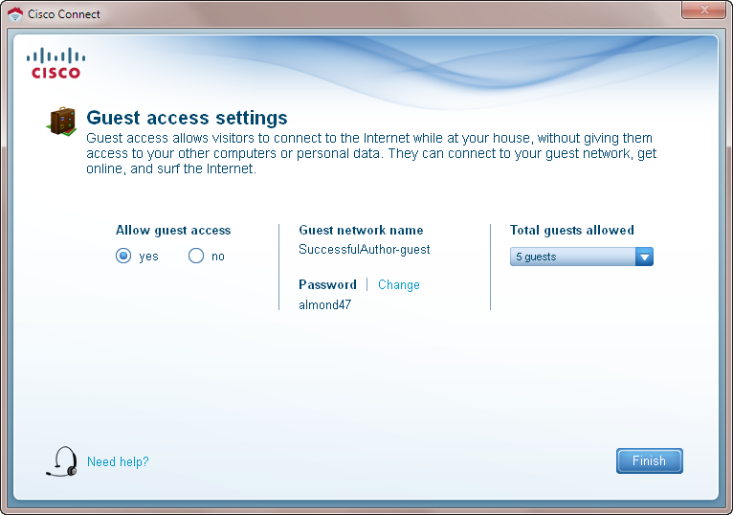
Identifying a
Perimeter Network
Understanding guest networks

Slide 18
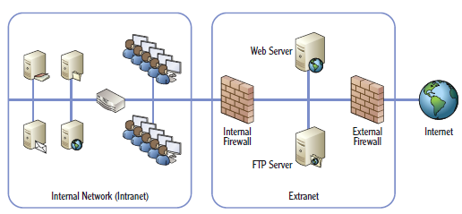
Understanding Extranets
Area between Internet and intranet
  Hosts resources for trusted entities

Slide 19
Chapter 11 Summary
Understanding risks on the Internet
Exploring an intranet
Understanding firewalls
Identifying a perimeter network
Understanding extranets

